Slide 1
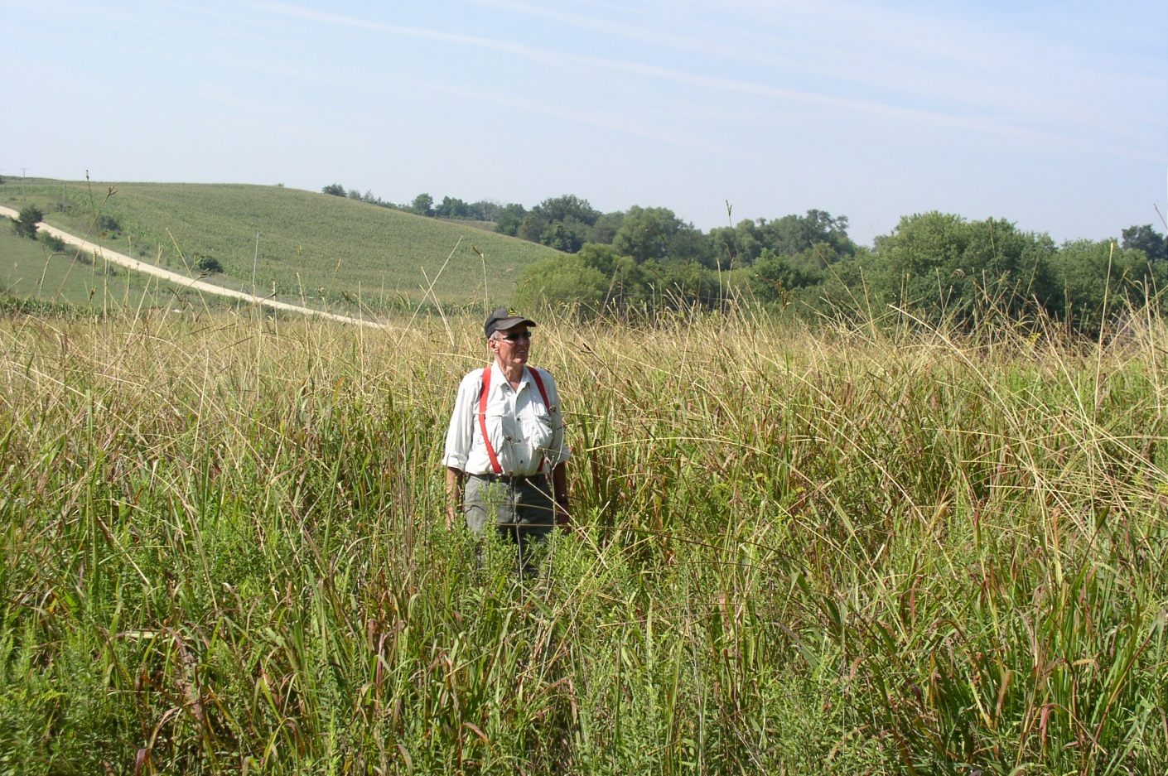
3/14/14
2014 Federal Farm Bill Overview
Notes:
Farm Bill Impacts on NRCS Program Administration
Two key words on changes to NRCS programs brought about by the 2014 Farm Bill:
Streamlining of programs and efforts brought about by consolidation of former programs, and;
Marginal changes in the operation, or “spirit” of conservation title. Future applicants will be offered much the same opportunities to improve their stewardship with greater ease and increased transparency.
USDA FB Conservation Program Facts:
USDA uses a variety of approaches for natural resource conservation. Nine USDA agencies have some conservation responsibility.
Farm Bill conservation programs protect soil, water, wildlife, and other natural resources on agricultural lands.
Conservation programs are important because they help limit environmental impacts of agriculture production activities both on and off the farm, and they can also help farmers maintain or improve production of food and fiber.
Some conservation programs center on improving or restoring resources that have been degraded, while others create conditions that will limit degradation in the future.

Slide 2
Conservation Compliance
“Recoupling” federal crop insurance premium support benefits to HEL and wetland conservation compliance requirements (Sod Buster and Swamp Buster)
Mandated USDA-assisted wetland mitigation banking program
New provisions apply solely to “crop insurance only” participants
.

Slide 3
Pollinators
Pollinator protection provisions enacted in 2008 extended to 2018
USDA to publish guidance on enhancing long term pollinator health and long term viability of pollinators.
Requirement to provide recommendations to Congress regarding how to better coordinate Federal agency efforts to address the decline of managed honey bees and native pollinators.
.
Notes:
Collaborative efforts

Slide 4
Conservation Reserve Program
CRP reauthorized but reduced from 32 million acres to 24 million acres over the next 5 years
Creates a two million acre reserve for grassland acres targeting expiring CRP. Cropping history not required.

Slide 5
Easement Programs
Farm & Ranch Land Protection Program (FRPP), Grassland Reserve Program (GRP), and Wetlands Reserve Program (WRP) have been repealed

Slide 6
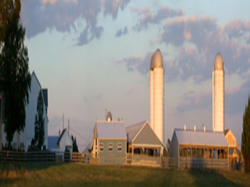
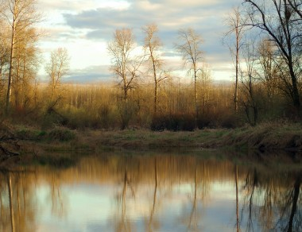
Easements
Agricultural Conservation Easement Program
FRPP
GRP
WRP
Notes:
The Farm Bill consolidates three conservation easement programs, WRP, FRPP, and GRP into a single program with two components, Wetlands and Agricultural Lands Easements. The wetlands component mirrors the WRP authorizing language and the agricultural land component is modeled after the FRPP.
The purposes of ACEP include:
Combine the purposes and coordinate the functions of the WRP, GRP, and FRPP.
Restore, protect, and enhance wetland on eligible land.
Protect the agricultural use, viability, and related conservation values of eligible land by limiting non-agricultural uses.
Protect grazing uses and related conservation values by restoring and conserving eligible land.
ACEP funded at $400 million in fiscal year 2014, increasing to $500 million in fiscal year 2017, and reducing to $250 million in fiscal year 2018. For the agricultural land easements, it maintains our certification process for partners. ACEP increases management flexibility for enrolled lands and all land previously enrolled in FRPP, GRP, and WRP is considered enrolled in ACEP.
While ACEP will require a new regulation for its implementation, there are very few new statutory provisions when compared to GRP, FRPP and WRP.
The main differences include:
Having program-wide authority to subordinate, modify, or terminate an easement under certain circumstances. Currently, only WRP has the authority to modify or terminate an easement. This will apply to our EWP Floodplain Easements as well.
The non-Federal contribution for the purchase of a agricultural land easement varies slightly from the FRPP non-Federal contribution. In particular if a landowner makes a charitable donation of a large percentage of the agricultural land easement’s fair market value, the landowner donation will reduce the Federal government’s contribution to a larger extent than what is currently required under FRPP. Additionally, NRCS can provide a greater share of the cost (up to 75 percent) for protecting grasslands of special environmental significance.

Slide 7
ACEP
ACEP has 2 components
Agricultural Land Easement Component (ALE)
Wetland Reserve Easement Component (WRE)

Slide 8
ACEP
The purposes of ACEP include:
Combine the purposes and coordinate the functions of the WRP, GRP, and FRPP.
Restore, protect, and enhance wetland on eligible land.
Protect the agricultural use, viability, and related conservation values of eligible land by limiting non-agricultural uses.
Protect grazing uses and related conservation values by restoring and conserving eligible land.

Slide 9
ACEP
ACEP funded at $400 million in fiscal year 2014, increasing to $500 million in fiscal year 2017, and reducing to $250 million in fiscal year 2018.
During FY 2014 USDA plans to develop and publish ACEP regulations to administer ACEP in FY 2015 and subsequent fiscal years.

Slide 10
ACEP
Wetland Reserve Easement (WRE)
Reduces ownership requirement from 7 years to 24 months
Authorizes waiver process to allow enrollment of CRP land established to trees.
No option to enroll stand-alone restoration cost-share agreements. (Not previously used in MN)
Notes:
WRE Component
Establishes ownership requirement prior to enrollment of 2 years; WRP had a 7 year ownership requirement – waiver provisions may still apply
Authorizes a waiver process to allow enrollment of CRP land established to trees – these lands were not eligible for WRP
No authority to enroll restoration cost-share agreements
The wetland reserve component maintains the goals of WRP, which is to achieve the greatest wetlands functions and values, along with optimum wildlife habitat, on every acre enrolled in the program.
The Secretary will still:
hold the easements.
Offer permanent easements, 30-year easements and 30-year contracts with Indian Tribes
Priority for enrollment continues to be based on the value of the easement for protecting and enhancing habitat for migratory birds and other wildlife.
Have the authority to grant compatible uses and reserve grazing rights.

Slide 11
Agricultural Land Easements (ALE)
The 2014 Farm Bill rescinds authority to enter into new agreements or contracts for GRP
The purposes of GRP are now contained within the Agricultural Conservation Easement Program – Agricultural Lands Easement
New requirement of 50% match – opportunity for MN to get grassland acres!

Slide 12
Wetland Reserve Easements (WRE)
NRCS will continue to
Hold easements
Keep WRP compensation and eligibility framework from the 2008 Farm Bill.
Priority for enrollment continues to be based on value of the easement for protecting and enhancing habitat for migratory birds and other wildlife

Slide 13
Wetland Reserve Easements (WRE)
Enrollment Options
Permanent
30-year Easement
30 year contract to Indian Tribes

Slide 14
Wetland Reserve Easements (WRE)
The enactment of the 2014 Act requires that new enrollments are made using ACEP-WRE authorities.
Transition guidance to address funding for prior year enrollment activities as well as new FY 2014 enrollments is forthcoming.

Slide 15
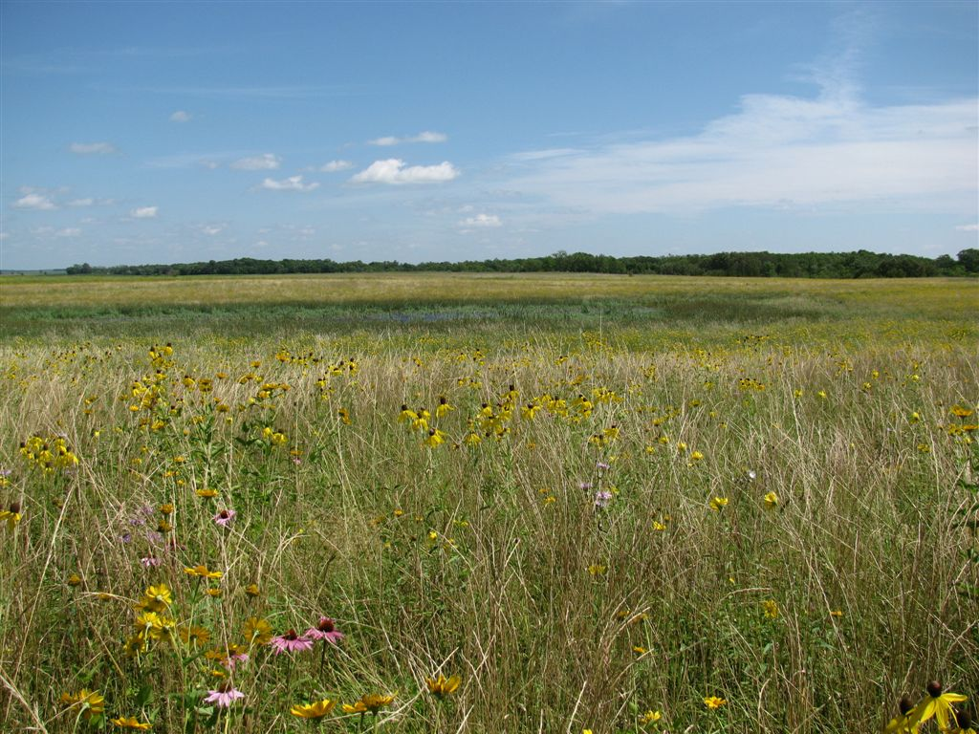
Regional Conservation Partnership Program (RCPP)
Notes:
The Regional Conservation Partnership Program (RCPP) promotes the implementation of conservation activities through agreements between partners and landowners. And identifies specific geographical regions or areas at the national and state level for targeted conservation activities. This program does have a degree of complexity in that there are three project funding pools – State, national, and critical conservation areas designated by the Secretary and there are four programs contributing funds, plus RCPP has its own source of funds. If funds are not committed to a project by April 1, they are to return to the contributing program.
The program uses two mechanisms to identify areas for enrollment into the program.
Partnership Project Areas: A partner organization proposes a project for a specific geographical area, ranging in size from, for instance, a local project affecting a particular sub-watershed and a few producers, up to projects that address resource needs of a state or multi-state area.
Critical Conservation Areas: The Secretary will designate up to six CCAs based on statutory ranking criteria. It is possible that the Statement of Managers in the Conference Report will clarify at least some of the areas that Congress intends to have met these criteria.
The CCA designation is based on the degree to which an area
Includes multiple States with significant agriculture production;
Is covered by an existing regional, state, bi-national, or multistate agreement or plan with established objectives, goals and work plans and is adopted by a Federal, State, or regional authority;
Has water quantity concerns, or
Is subject to regulatory requirements that could reduce the economic scope of agricultural operations within the area.
RCPP is a new program that combines four former conservation programs;
RCPP consolidates the provisions in the following three programs and initiative into one program:
The Agricultural Water Enhancement Program (AWEP);
The Chesapeake Bay Watershed Program (CBWP);
The Cooperative Conservation Partnership Initiative (CCPI); and,
The Great Lakes Basin Program (GLBP).
Projects may focus on water quality and quantity, erosion, wildlife habitat, drought and flood control or other regional priorities.
By encouraging partners to cooperate with producers, the U.S. Department of Agriculture (USDA) Natural Resources Conservation Service (NRCS) hopes to further the conservation, restoration and sustainable use of soil, water, wildlife and related natural resources on a regional or watershed scale.
Funding is delivered through the:
Conservation Stewardship Program;
Environmental Quality Incentives Program;
Healthy Forests Reserve Program, and;
Agricultural Conservation Easement Program.
Partnership agreements may not exceed five years; however, NRCS may extend the agreement one time for up to 12 months when an extension is necessary to meet the objectives of the program. The partnership agreement defines the scope of the project, including:
The eligible activities to be implemented
The potential agricultural or nonindustrial private forest operation affected
The local, State, multi-State or other geographic area covered
The planning, outreach, implementation and assessment to be conducted

Slide 16
RCPP
RCPP is a new regional program that:
Furthers the conservation, restoration, and sustainable use of soil, water, wildlife on a regional scale
Encourages partners to cooperate with producers
Provides assistance through:
Partnership agreements
Program contracts or easement agreements
Combines and replaces the purposes and functions of previous partnerships such as MRBI

Slide 17
RCPP
Covered programs:
Agricultural Conservation Easement Program (ACEP)
Environmental Quality Incentives Program (EQIP)
Conservation Stewardship Program (CStP)
Healthy Forests Reserve Program (HFRP)

Slide 18
RCPP Funding
Available Funding
$100 Million of Direct RCPP funding each year
7% of funds from the four covered programs (ACEP, CStP, EQIP, HFRP) reserved annually through April 1st

Slide 19
RCPP Funding
Funding Allocation
25% for State Projects
40% for National Projects
35% for Projects in Critical Conservation Areas

Slide 20
RCPP
Critical Conservation Areas
Secretary will select up to 8 critical conservation areas
Priority consideration given to geographical areas which:
Include multiple States with significant ag production
Have an existing agreement or work plans
Benefit water quality and quantity improvement
Assist producers to meet natural resource regulatory requirements

Slide 21
RCPP
Partnership Agreements:
NRCS will conduct a competitive process to select applications for partnership agreements
NRCS will make public the criteria used in evaluating

Slide 22
RCPP
Partners are responsible for:
Contributing a significant portion of the overall costs
Conducting outreach and education
Leveraging financial or technical assistance provided by NRCS with additional funds to help achieve the project objectives.
Conducting and providing an assessment of the project costs and conservation effects
No funding may be used to cover partner administrative costs

Slide 23
RCPP
RCPP will be implemented this year.
Additional guidance on fund distribution and program management will be provided.

Slide 24
VPA-HIP (aka Walk-In Access)
$40 M over 5 years

Slide 25
Questions?
CONTACT:
Bill Penning
Conservation Easement Section Manager
Board of Water and Soil Resources
Bill.penning@state.mn.us

